Slide 1

Store sales prediction
MUHAMMED SHIBIL C V

Slide 2
OBJECTIVES
The product perspective of the store sales prediction project is focused on providing a solution that can be used by retailers to make data-driven decisions and improve their business performance. The product will take the form of a software application or a platform that can be integrated with a retailer's existing systems. The product will provide retailers with the ability

Slide 3
Benefits:
store sales prediction is a crucial problem for retailers as it helps them make data-driven decisions to optimize their inventory, marketing, and other operational decisions. The goal of this project is to use historical sales data and other relevant information to predict future sales for a particular store or group of stores, and provide retailers with insights that can help them improve their business performance.

Slide 4
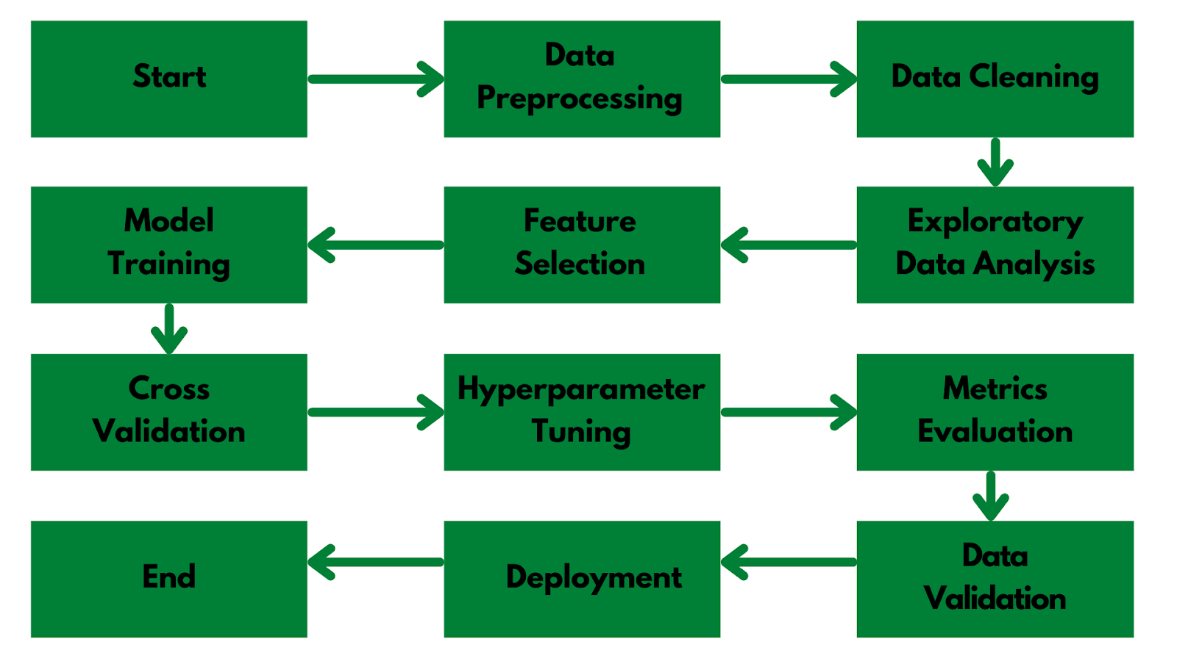
Architecture

Slide 5
Frequent Q&A
Q) What is the source of the data?
Data was collected from Kaggle, but city specific data can be collected from Central Board of Pollution website.
Q) What is the complete flow of your project?
Refer to slide no 4 for better understanding.
Q) What techniques were you using for data pre-processing?
In data pre processing, we analyzed the data, found the important features, and based on the domain knowledge, we eliminated the unnecessary columns. We also tried to fill Missing Values with mean, median and mode but still the data have the same correlations. Thus removing the columns with high NaN values was the better option for us.

Slide 6
Q) How did you choose the model?
After implementing hyper parameter tuning, we were able to do model selection based on the metrics and how it was performing on unseen data. The final model we chose was Random Forest Classifier.

Slide 7
Q) What are the different stages of deployment?
When the model was ready, we deployed the model using Streamlit on Heroku and performed some test.
We added the common values or ranges of each parameter to better help the user to select the value.
We then created the Explore page with the help of our EDA notebook where we embedded different types of graphs for each parameters.
We then added the animations and improved the user interface.
Once everything was finalized, we deploy it in production.

Slide 8
THANK YOU

